Slide 1
Engineering Physics Laboratory
(Course Code : PHY119)
Experiment Number: 4
AIM: To determine the dielectric constant of unknown solid material

Slide 2
Learning Objectives
To understand the concept of dipole moment, capacitance and permittivity.
2. To find out the dielectric constant of any unknown substance
3. To understand the factors affecting the capacitance of the material.
4. To understand the close relation between capacitance and permittivity

Slide 3
Background

Slide 4
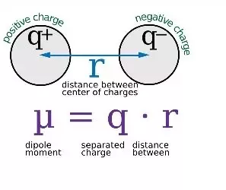
Dipole moment
* Dipole moments occur when there is a separation of charge. They can occur between two ions in an ionic bond or between atoms in a covalent bond
* The dipole moment is a measure of the polarity of the molecule
* When two electrical charges, of opposite sign and equal magnitude, are separated by a distance, an electric dipole is established
* The size of a dipole is measured by its dipole moment (μ). Dipole moment is measured in Debye units, which is equal to the distance between the charges multiplied by the charge (1 Debye equals 3.34×10⁻³⁰Cm).

Slide 5
Polarizability
Polarizability is a measure of how easily an electron cloud is distorted by an electric field. Typically the electron cloud will belong to an atom or molecule or ion. The electric field could be caused, for example, by an electrode or a nearby cation or anion.
If an electron cloud is easy to distort, we say that the species it belongs to is polarizable
Polarizability, which is represented by the Greek letter alpha, α, is experimentally measured as the ratio of induced dipole moment p to the electric field E that induces it:
α = p/E

Slide 6
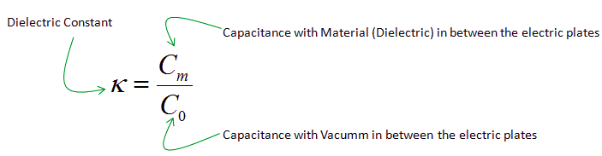
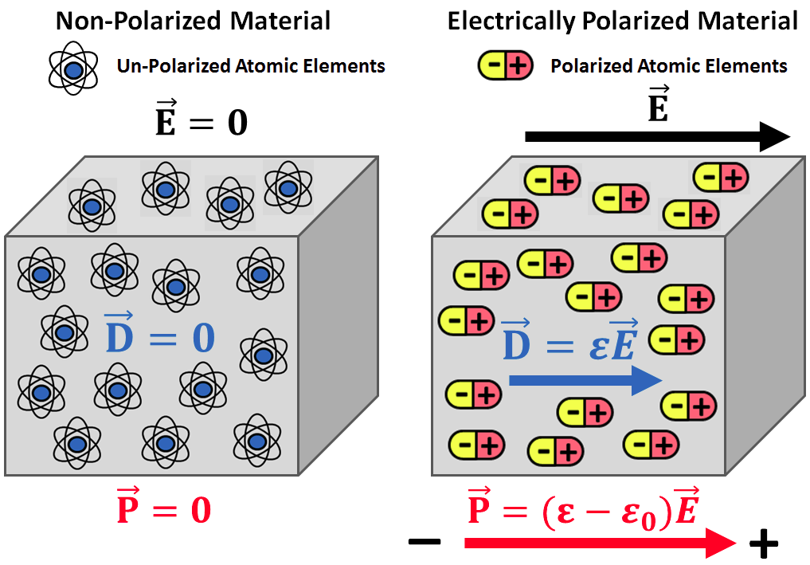
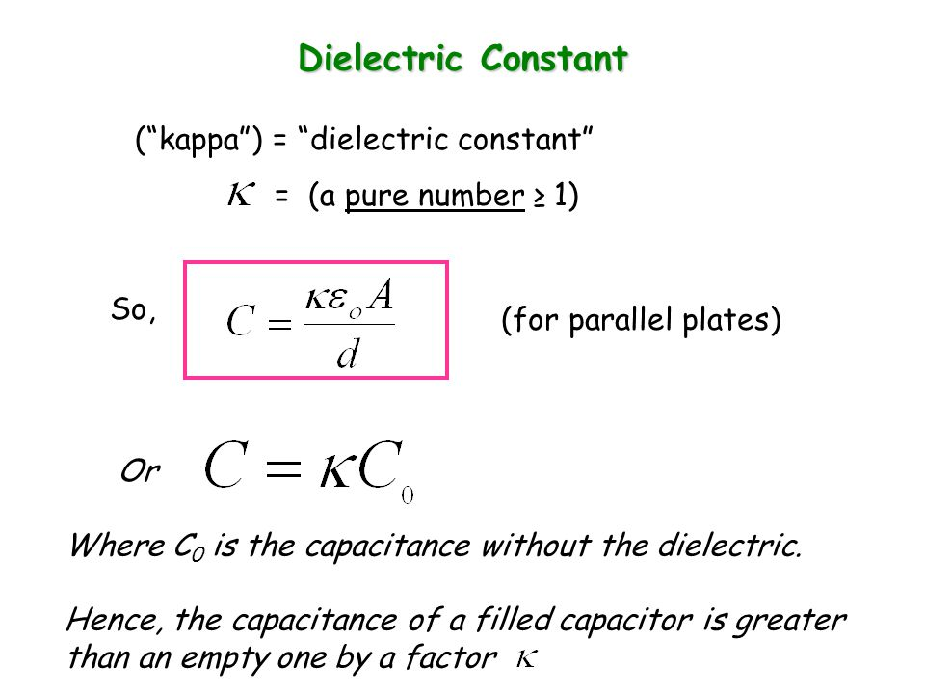
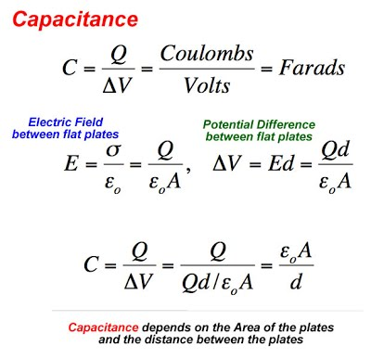
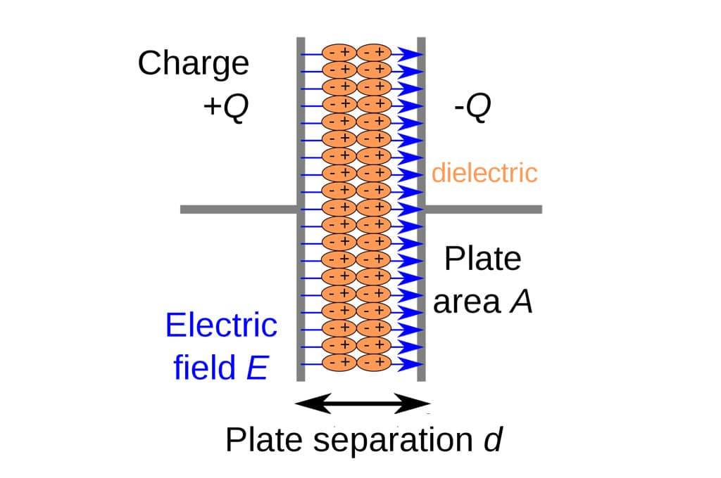
Dielectric constant

Slide 7
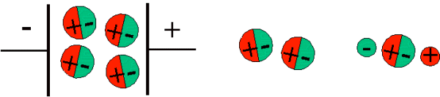
The measurement
It is relatively easy to measure dipole moments; just place a substance between charged plates (Figure 2) and polar molecules increase the charge stored on plates and the dipole moment can be obtained (i.e., via the capacitance of the system)
Figure:2 Polar molecules align themselves in an electric field (left), with respect to one another (middle), and with respect to ions (right)

Slide 8
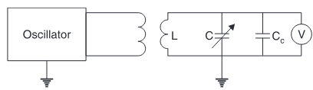
Experiment set up in LPU
First the capacitance of a test capacitor, C0, is measured with vacuum between its plates. Then, using the same capacitor and distance between its plates, the capacitance Cx with a dielectric between the plates is measured. The relative dielectric constant can be then calculated as €r = Cx/C0
https://www.youtube.com/watch?v=h76L123cKXI

Slide 9
Experiment video (for resonance method)
(1) Click on the YouTube video link: https://www.youtube.com/watch?v=h76L123cKXI

Slide 10
Step By Step guide to perform the experiment by D.C. technique
The formula used is

Slide 11
Procedure
Step:1 open the link:
https://phet.colorado.edu/sims/cheerpj/capacitor-lab/latest/capacitor-lab.html?simulation=capacitor-lab
Step:2 Measure the value of capacitance with air in between the plates of capacitor and call it C0, (keep constant area and plate distance)
Step:3 Go to the “ Dielectric tab” and insert Teflon as the dielectric between the plates of the capacitor and measure the value of C, call it Cm
Use the formula to calculate the Dielectric constant of Teflon
Repeat the experiment for paper and glass.

Slide 12
Observation Table
Parameters: Plate area: ----------- , Seperation between plates: -----------------
Dielectric Material | Capacitance | Dielectric constant | % error
air | C0= | ------
Teflon | Cm=
Paper
Glass

Slide 13
Understanding based Q Session
Q:1 Dielectric materials are
(a) Poor conductors
(b) excellent semiconductors
(c) Ideal for charge storage
(d) None of the above

Slide 14
Q:2 If a material possesses high dielectric constant then the capaciance of that material is
(a) High
(b) Very low
(c) Does not depend on it
(d) exactly half of it

Slide 15
Q:3 The value of Dielectric constant depends on
(a) Frequency of applied field
(b) Humidity
(c) Temperature
(d) all of the above

Slide 16
Q:4 If material possesses low dielectric constant then its polarizability will be
(a) Low
(b) High
(c) will remain constant
(d) cannot say anything

Slide 17
Q:5 In a capacitor the electric charge is stored in
A. Metal plates
B. Dielectric
C. Both A and B
D. None of the above

Slide 19
Activity based questions
https://phet.colorado.edu/sims/cheerpj/capacitor-lab/latest/capacitor-lab.html?simulation=capacitor-lab

Slide 20
Q:A1 Consider system of a single electron and proton separated by a fix distance of 200 pm. Calculate the dipole moment of the system in Debye Unit. Repeat the calculations for distances (a) 400 pm (b) 600 pm (c) 100 pm (d) 800 pm and Plot the graph between distance of elementary particles and dipole moment. (Submit with Journal)

Slide 21
Q:A2. ±1.5 V battery is connected between two plates of the air capacitor. Plot the graph between capacitance and the distance between the plates by varying the distances as 5.5 mm, 6.5 mm, 7.5 mm, 8.5 mm, 9.5 mm and 10 mm. Comment on it (Submit with journal)

Slide 22
Q:A3. ± 1.5 V battery is connected between two plates of the air capacitor separated by the distance 5 mm. Tabulate the values of capacitance by changing the plate area as 100 mm², 150 mm², 200 mm², 250 mm², 300 mm², 350 mm² and 400 mm² and explain your observation on their relationship. (Submit with journal)

Slide 23
Q:A4. ± 1.5 V battery is connected between two plates of the capacitor separated by the distance 5 mm of the area 100 mm². The value of capacitance is maximum for the material between the plates as
(a) air
(b) Teflon
(c) Paper
(d) Glass

Slide 24
Q:A5. ± 1.5 V battery is connected between two plates of the Teflon dielectric having the distance 5 mm and area 100 mm². Tabulate the values of capacitance if the Teflon displaces/is offset at (a) 2 mm (b) 4 mm (c) 6 mm (d) 8 mm and (e) 10 mm. The value of capacitance with the offset distance
(a) Increases
(b) Decreases
(c) Remains same
(d) cannot perform the mentioned distances

Slide 25
Q:A6. One can increase the plate charge by
(a) Increasing the plate area
(b) Decreasing the distance between plates
(c) Increasing the applied voltage
(d) All of the above

Slide 26
Q:A7. If the distance between two plates of the capacitor is increased then the stored energy will
(a) Increase
(b) Decrease
(c) remains same
(d) cannot say

